Slide 1
Team Blinkers
DevJams '21
Track: Digital Accessibility

Slide 2
PROBLEM STATEMENT
Problem
Digital Accessibility is still very scarce amongst people who are physically handicapped or suffer with muscle atrophy problems.
The power of internet is not being completely exploited to not only bring in entertainment but also for healthcare and communication

Slide 3
Solution
THE UTOPIA
We put together a solution to bring digital accessibilty at the conviniece of those for whom traditional digital access is still a problem.
We try to integrate a fully functional one stop destination for the one's who are physically handicapped or unable to access web resources by means of normal interface.
Our goal is to revolutionize the means of accessing the world wide web at their own convenience and also bring together emergency and health features to cater one's needs.

Slide 4
Blinkerz
Your destination is one blink away!

Slide 5
Step 1
One call to discuss the
idea the hack
Birth of Blinkerz
Checked out the Digital Accessibility track.
Step 2
Found out the people for whom Digital Accessibility
was still an issue
Step 3

Slide 6
TIMING
Reason 1
Internet is growing at a rapid pace. People who are physically challenged are equally capable of moving forward and there must be no hinderance to access the internet for education or entertainment.
Reason 2
To keep record of medical stats and also track health diseases which can be easily tracked with the help of modern sensors and gadge

Slide 7
Working of Blinkerz
2. A short blink refers to next option whereas a long blink
can be used to select a button
3. Scanning of various health parameters using sensors
from smart watches
1. We navigate through out the web application using
detections of blinks
6. Contact Emergency contacts in times for serious
emergencies using automated whatsapp messages
4. Using third party API calls to access resources on the
web
5. Trained ML Models to scan for diseases such as heart failures and diabetes.

Slide 8
Tech Stack
Step 1
Step 1
OpenCV
Python Flask Frame
Step 2
Selenium Web Driver
Step 2
HTML/CSS/JS
Step 3
scikit-learn
Step 3
Numpy/Pandas

Slide 9
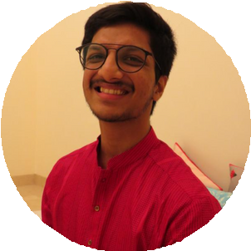
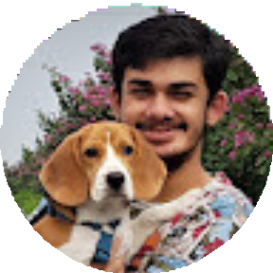
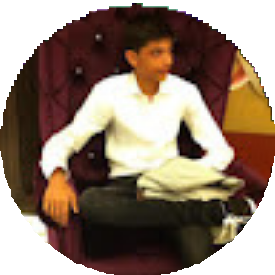
Aviral Jain
Backend & ML
Arhit Bose Tagore
Backend & ML
The Team
Vidipt Khetriwal
Frontend

Slide 10
THANK YOU

